Slide 1
DC Permanent Magnet Motors A tutorial winch design
David Giandomenico
Lynbrook High School Robotics
FIRST Team #846
DGiandomenico@lynbrookrobotics.com
(408)343-1183
Notes:
FIRST robots have drive trains, arms, winches, lifts…operated by DC permanent motors. In describing how to use motors, this tutorial lecture will discuss motor characteristics, efficient (and inefficient!) use of motors, gearbox friction, and general physics concepts such as torque, work, and power.

Slide 2
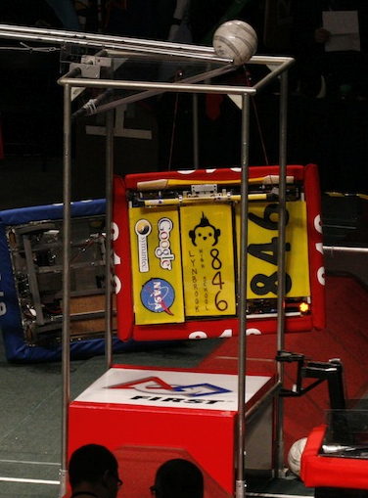
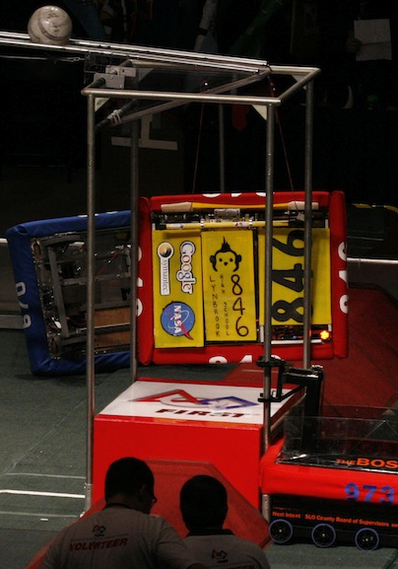
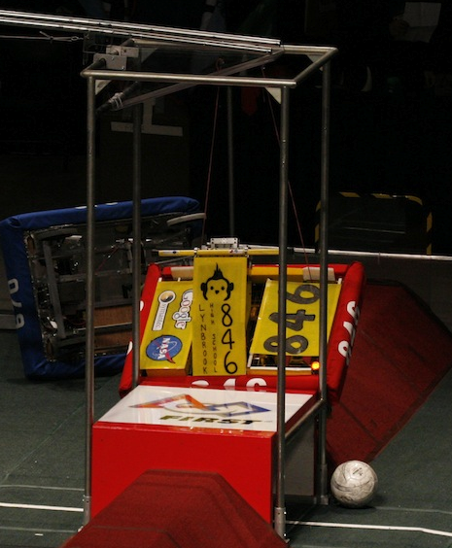
2010 Breakaway

Slide 3
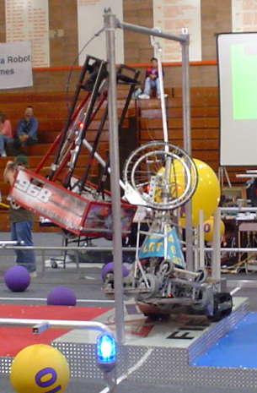
2004 FIRST Frenzy: Raising the Bar
Notes:
2004 FIRST Competition;Attach to 10ft high bar and
lift robot off ground. What is the design criteria?

Slide 4
What We Want.
Weight:
Distance:
Time (speed):
130 lbs
1.5 feet
5 seconds

Slide 5
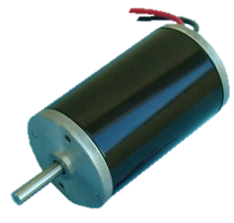
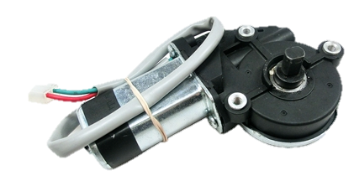
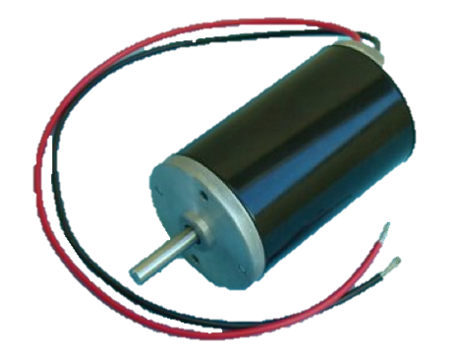
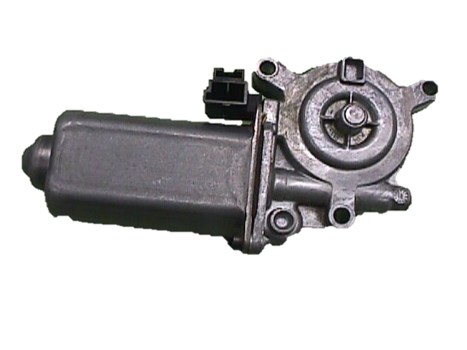
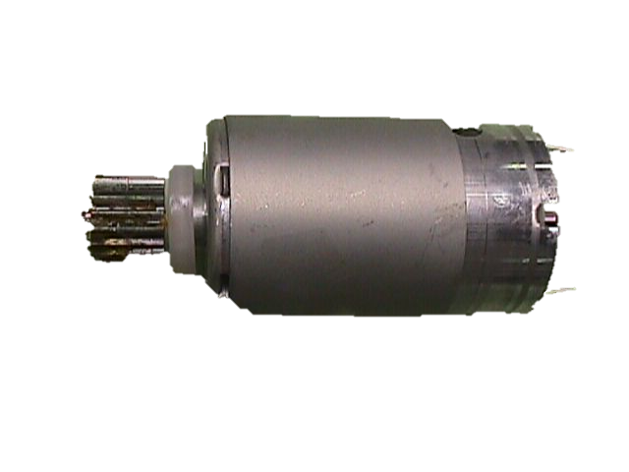
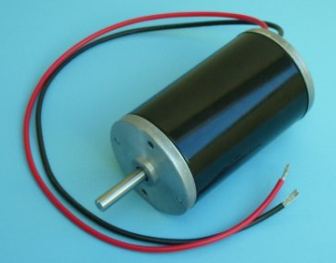
What We’ve Got: Some of the Motors supplied in FIRST Robotics Kit

Slide 6
Kit Motors – Which One?
All Data at 12VDC
2013 choices (partial list!)
Make Model | Max Power (W) | Stall Torque (oz-in) | Free Speed (rpm) | Free Current (A) | Stall Current (A)
AndyMark am-0912 | 179 | 61 | 16000 | 1.2 | 64
AndyMark am-0915 | 45 | 1209 | 198 | 0.6 | 22
BaneBots M7-RS775-18 | 273 | 113 | 13000 | 1.8 | 87
BaneBots M5-RS550-12 M5-RS550-12-B | 254 | 71 | 19300 | 1.4 | 85
BaneBots M5-RS540-12 | 123 | 39 | 16800 | 1 | 42
BaneBots M7-RS775-12 | 83 | 61 | 7300 | 1.1 | 30
BaneBots M5-RS545-12 | 74 | 24 | 16800 | 0.9 | 21
BaneBots M3-RS395-12 | 48 | 17 | 15500 | 0.5 | 15
CIM FR801-001 | 337 | 343 | 5310 | 2.7 | 133
VEX Mini CIM 217-3371 | 229 | 198 | 6200 | 1.8 | 86
VEX bag motor 217-3351 | 149 | 57 | 14000 | 1.8 | 41

Slide 7
Motors - Sorted by Power
Make Model | Max Power (W) | Stall Torque (oz-in) | Free Speed (rpm) | Free Current (A) | Stall Current (A)
CIM FR801-001 | 337 | 343 | 5310 | 2.7 | 133
BaneBots M7-RS775-18 | 273 | 113 | 13000 | 1.8 | 87
BaneBots M5-RS550-12 M5-RS550-12-B | 254 | 71 | 19300 | 1.4 | 85
VEX Mini CIM 217-3371 | 229 | 198 | 6200 | 1.8 | 86
AndyMark am-0912 | 179 | 61 | 16000 | 1.2 | 64
VEX bag motor 217-3351 | 149 | 57 | 14000 | 1.8 | 41
BaneBots M5-RS540-12 | 123 | 39 | 16800 | 1 | 42
BaneBots M7-RS775-12 | 83 | 61 | 7300 | 1.1 | 30
BaneBots M5-RS545-12 | 74 | 24 | 16800 | 0.9 | 21
BaneBots M3-RS395-12 | 48 | 17 | 15500 | 0.5 | 15
AndyMark am-0915 | 45 | 1209 | 198 | 0.6 | 22

Slide 8
“CIM” Motor Specification
Notes:
Complicated. What do we look for?

Slide 9
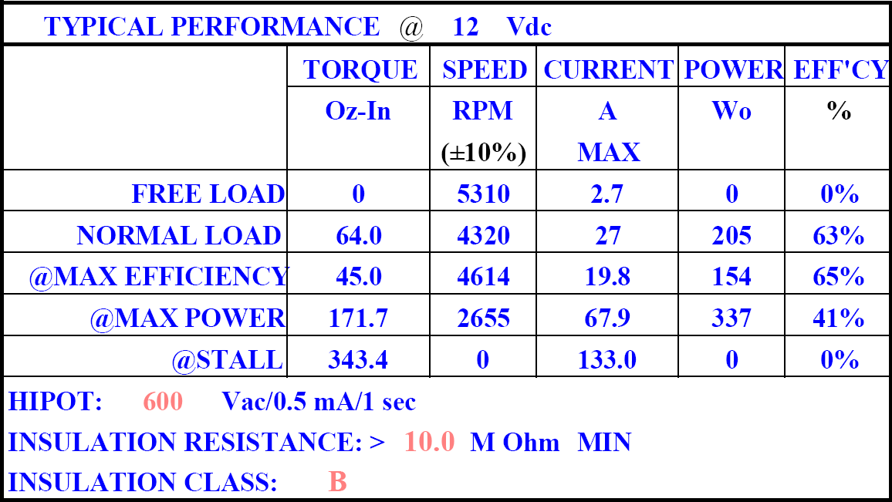
“CIM” Motor Performance
Notes:
Key data. All graphs can be determined from 4 numbers. In order, No Load speed (aka free speed),

Slide 10
“CIM” Motor Performance
No Load Speed
Stall
Current
No Load
Current
Stall
Torque

Slide 11
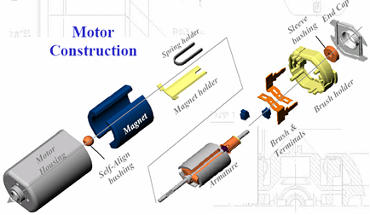
www.johnsonmotor.com

Slide 12
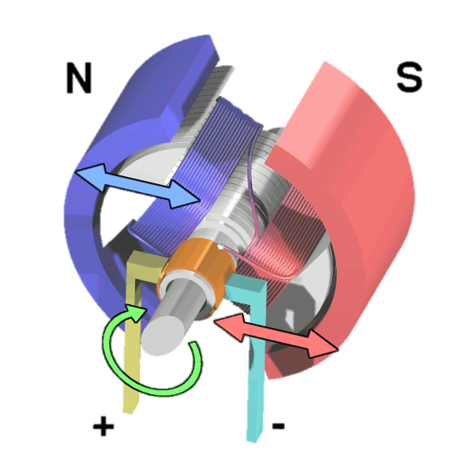
Operation of a simple
DC Brushed Motor
Current flow creates magnetic field
Opposite N-S poles attract causing rotation
When N pole of rotor reaches N magnet, current is reversed.
Photo from Wapcaplet / Wikipedia

Slide 13
Current Limits (fuse) on Motor Power
Stall
Current
40 A Fuse Limit
~100 Oz-In
Notes:
Motor is also limited by the lesser of the branch circuit current limit (Fuse rating), and the current rating of the motor.
The current rating of the motor may not be specified. A motor should be able to operate continuously at it’s most efficient operating point (~15-20% of the stall current; 85-75% of NoLoad Speed)

Slide 14
Choosing a motor based on Maximum Output Power
Calculate Energy required to lift load.
Given the Time & Energy, calculate the mechanical Power required.
Boost Power requirement to adjust for Friction in the gearbox and elsewhere.
Choose a motor whose Maximum Output Power is at least 4/3 * (safety margin)
Notes:
Typical operating output power is no more than ¾ or 75% ( 1 over 4/3) of the Max Out power – which we will see later.
Gearbox friction may be around 60-80%, depending on the # of gears among other factors.

Slide 15
Basic equations of a
DC Brushed Motor
for Ideal Motor, using MKS unit system
Photo from Wapcaplet / Wikipedia
Notes:
Key points: Torque is proportional to current; Speed scales with Voltage; Relations are Linear; When wf is at max speed, i -> 0; when w->, I -> V/Rm

Slide 17
Motor Selection
Make Model | Max Power (W) | Stall Torque (oz-in) | Free Speed (rpm) | Free Current (A) | Stall Current (A)
CIM FR801-001 | 337 | 343 | 5310 | 2.7 | 133
BaneBots M7-RS775-18 | 273 | 113 | 13000 | 1.8 | 87
BaneBots M5-RS550-12 | 254 | 71 | 19300 | 1.4 | 85
VEX Mini CIM 217-3371 | 229 | 198 | 6200 | 1.8 | 86
AndyMark am-0912 | 179 | 61 | 16000 | 1.2 | 64
VEX bag motor 217-3351 | 149 | 57 | 14000 | 1.8 | 41
BaneBots M5-RS540-12 | 123 | 39 | 16800 | 1 | 42
BaneBots M7-RS775-12 | 83 | 61 | 7300 | 1.1 | 30
BaneBots M5-RS545-12 | 74 | 24 | 16800 | 0.9 | 21
BaneBots M3-RS395-12 | 48 | 17 | 15500 | 0.5 | 15
AndyMark am-0915 | 45 | 1209 | 198 | 0.6 | 22
Make Model | Max Power (W) | Stall Torque (oz-in) | Free Speed (rpm) | Free Current (A) | Stall Current (A)
CIM FR801-001 | 337 | 343 | 5310 | 2.7 | 133
BaneBots M7-RS775-18 | 273 | 113 | 13000 | 1.8 | 87
BaneBots M5-RS550-12 | 254 | 71 | 19300 | 1.4 | 85
VEX Mini CIM 217-3371 | 229 | 198 | 6200 | 1.8 | 86
AndyMark am-0912 | 179 | 61 | 16000 | 1.2 | 64
VEX bag motor 217-3351 | 149 | 57 | 14000 | 1.8 | 41
BaneBots M5-RS540-12 | 123 | 39 | 16800 | 1 | 42
BaneBots M7-RS775-12 | 83 | 61 | 7300 | 1.1 | 30
BaneBots M5-RS545-12 | 74 | 24 | 16800 | 0.9 | 21
BaneBots M3-RS395-12 | 48 | 17 | 15500 | 0.5 | 15
AndyMark am-0915 | 45 | 1209 | 198 | 0.6 | 22
Make Model | Max Power (W) | Stall Torque (oz-in) | Free Speed (rpm) | Free Current (A) | Stall Current (A)
CIM FR801-001 | 337 | 343 | 5310 | 2.7 | 133
BaneBots M7-RS775-18 | 273 | 113 | 13000 | 1.8 | 87
BaneBots M5-RS550-12 | 254 | 71 | 19300 | 1.4 | 85
VEX Mini CIM 217-3371 | 229 | 198 | 6200 | 1.8 | 86
AndyMark am-0912 | 179 | 61 | 16000 | 1.2 | 64
VEX bag motor 217-3351 | 149 | 57 | 14000 | 1.8 | 41
BaneBots M5-RS540-12 | 123 | 39 | 16800 | 1 | 42
BaneBots M7-RS775-12 | 83 | 61 | 7300 | 1.1 | 30
BaneBots M5-RS545-12 | 74 | 24 | 16800 | 0.9 | 21
BaneBots M3-RS395-12 | 48 | 17 | 15500 | 0.5 | 15
AndyMark am-0915 | 45 | 1209 | 198 | 0.6 | 22

Slide 18
2011 Fisher Price Motor
All Data at 12VDC
Make / Model | Max Power (Watts) | Stall Torque (oz-in) | Free Speed (RPM) | Free Current (A) | Stall Current (A)
Fisher-Price 00801-0673-(2011) | 291.6 | 75.4 | 20,770 | 0.82 | 108.7
Convert oz-in to N-m:
1 oz-in = 0.007061552 N-m
Make / Model | Max Power (Watts) | Stall Torque (N-m) | Free Speed (RPM) | Free Current (A) | Stall Current (A)
Fisher-Price 00801-0673-(2011) | 291.6 | 0.532 | 20,770 | 0.82 | 108.7

Slide 19
Fisher Price Motor 2010
V=12VDC
From FIRST_MOTOR_CALC.xls

Slide 20
What is Torque?
But isn’t that “Work?”
Notes:
Clarify point of confusion;

Slide 21
Units of Work vs. Torque
Work (Energy)
Torque
ft-lbf, Joules (=N-m), KWh, …
pound feet(lbf-ft), ft-lbf, oz-in, N-m …

Slide 22
Work in a Rotating System
Force
T
r

Slide 23
Power, Torque & Speed

Slide 24
Where is Max Power?
Fisher Price Motor 2011
V=12VDC
(speed,torque)
From FIRST_MOTOR_CALC.xls
Notes:
Mechanical output power is area under curve

Slide 25
Maximum Power
Fisher Price Motor 2011
V=12VDC
From FIRST_MOTOR_CALC.xls
Notes:
Area of boxes results in inverted parabola.

Slide 26
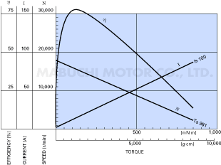
Standardize through Normalization
http://www.mabuchi-motor.co.jp
http://www.johnsonmotor.com
Notes:
Every motor has it’s own numbers, but otherwise looks very similar. We can better understand motors if we normalize the speed and torque.

Slide 27
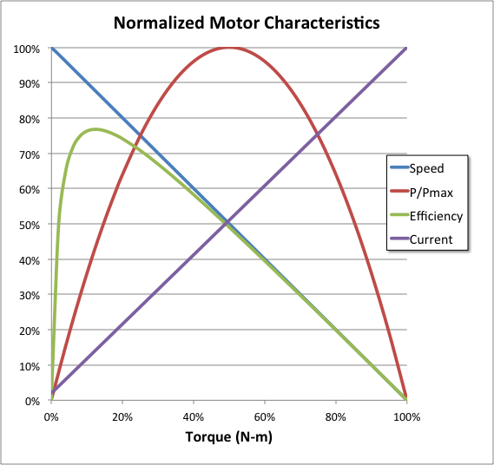
Simplified through Standardization
http://www.mabuchi-motor.co.jp
http://www.johnsonmotor.com
Notes:
Normalized.

Slide 28
V=Rated Voltage
85%+15%=100%
50%+50%=100%
30%+70%=100%
From FIRST_MOTOR_CALC.xls
Notes:
Curve may be normalized. Makes computation much easier.

Slide 29
Speed & Torque in a DC PM Motor
Let α={0,100%} such that
Notes:
Speed indicated as N; Torque indicated by T

Slide 30
Speed & Torque in a DC PM Motor
Using calculus, Max Power occurs when:
Or, w/o calculus, Max occurs between two roots of quadratic, at α=0, α=1 that is,
α=½ or equivalently, when α=50%

Slide 31
Max Power in a DC PM Motor

Slide 32
V=Rated Voltage
75%
From FIRST_MOTOR_CALC.xls

Slide 33
2011 Fisher Price Motor
All Data at 12VDC
Make / Model | Max Power (Watts) | Stall Torque (N-m) | Free Speed (RPM) | Free Current (A) | Stall Current (A)
Fisher-Price 00801-0673-(2011) | 291.6 | 0.532 | 20,770 | 0.82 | 108.7

Slide 34
Fisher Price Motor 2011
V=12VDC
From FIRST_MOTOR_CALC.xls

Slide 35
Fisher Price Motor 2011
V=12VDC
Current rises linearly with Torque
From FIRST_MOTOR_CALC.xls

Slide 36
Motor Current
Where α is the % No Load speed
Notes:
Simple linear Model for Current.

Slide 37
Electrical Power
Notes:
With fixed 12V applied, then input power simply follows the current.

Slide 38
Fisher Price Motor 2011
V=12VDC
Input power is Current X Voltage
From FIRST_MOTOR_CALC.xls
Notes:
Note: Io is commonly a few percent of I stall.
Question: If we plotted the output power on the same graph, how would it look?

Slide 39
Fisher Price Motor 2011
V=12VDC
From FIRST_MOTOR_CALC.xls
Notes:
Consider Motor Current.

Slide 40
Fisher Price Motor 2011
V=12VDC
From FIRST_MOTOR_CALC.xls

Slide 41
Fisher Price Motor 2011
V=12VDC
From FIRST_MOTOR_CALC.xls
Notes:
Power out / Power In; Because we can write the output power and the input power as equations, we can also write an equation for the efficiency. With a little calculus it is also easy to write a formula for the speed that yields the Max Efficiency.

Slide 42
Fisher Price Motor 2011
V=12VDC
From FIRST_MOTOR_CALC.xls
Notes:
When Normalized, the efficiency peaks around 10%-15% for most motors.
This is determined by the ratio of the Free Speed current and the Stall Current.

Slide 43
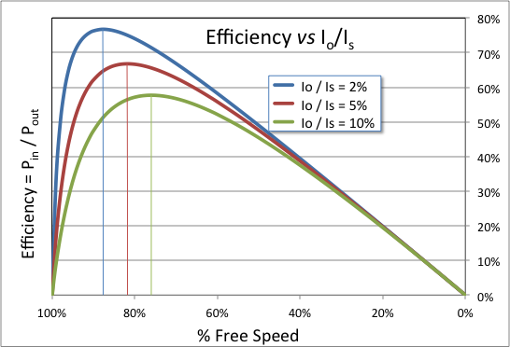
Normalized Efficiency for IDEAL motor
Notes:
This shows dependency on Io/Is ratio. It doesn’t consider motor’s (Ts Wf) / ( V Is ), hence the “IDEAL”
Note that at 50% Free Speed, where “Max Power” is obtained, the efficiency approaches 50%.

Slide 44
Max Efficiency
Operating Point:
Efficiency:

Slide 45
^{Derivation of:} Max Efficiency
Efficiency:
Where:
Find Maximum :
...simplifying yields:
Use Quadratic Formula to find roots:

Slide 46
^{Derivation of:} Max Efficiency _{continued}
Substitute for (1-α) to get:

Slide 47
DC PM Motor Summary
Max Power occurs at 50% No-Load Speed
Best efficiency typically occurs at about 80%-93% No-Load Speed
Most DC PM Motors will overheat if operated continuously at speeds less than 50% when full voltage is applied.

Slide 48
Gear Loss Estimate
Suppose we have n=3 inline sets of gears, each with a 4:1reduction. What is the total efficiency if each gear set loses 4%?
η_{T} = η_{i}^{n}
or η_{T} = (100%-4%)³ = 88.5%

Slide 49
When x is small,
Notes:
Answer: Why adding losses can be a reasonable approximation. Following slides have more detail why this is true for anyone who just has to know! ☺

Slide 50
Estimate of how many gear sets.
Suppose we want a gear reduction of 1200. How many gear sets with a reduction of 3 do we need?
Solve 3^{N} = 1200
N = ln(1200)/ln(3) = 6.45
Notes:
…Back to the task at hand. We need a winch that can turn fairly slowly. How can we determine gearhead efficiency when we don’t know what the gearing arrangement will be?

Slide 51
Gear loss estimate
We need 6.45 3:1 gear sets. Assuming a loss of 5% for each gear set,
η_{T} = η_{i}^{n}
or
η_{T} = (1-5%)^{6.45} = 71.8%
Notes:
Clearly, we can’t have 6.45 gear sets, a non-integer quantity. But as an estimate, this number is sufficient.

Slide 52
Putting it all together
Choose a winch drum size
Calculate the drum rpm
Choose the % motor operating speed
Calculate the required gear reduction to operate at that speed
Verify the output winch line force meets or exceeds the original specification, including gear box losses
Notes:
Other methods are possible, and perhaps preferable. This is straightforward, requiring a bit of trial and error, but without the complexity of completely analyzing all the tradeoffs.

Slide 53
Winch Design Specification

Slide 54
Winch Drum Speed

Slide 55
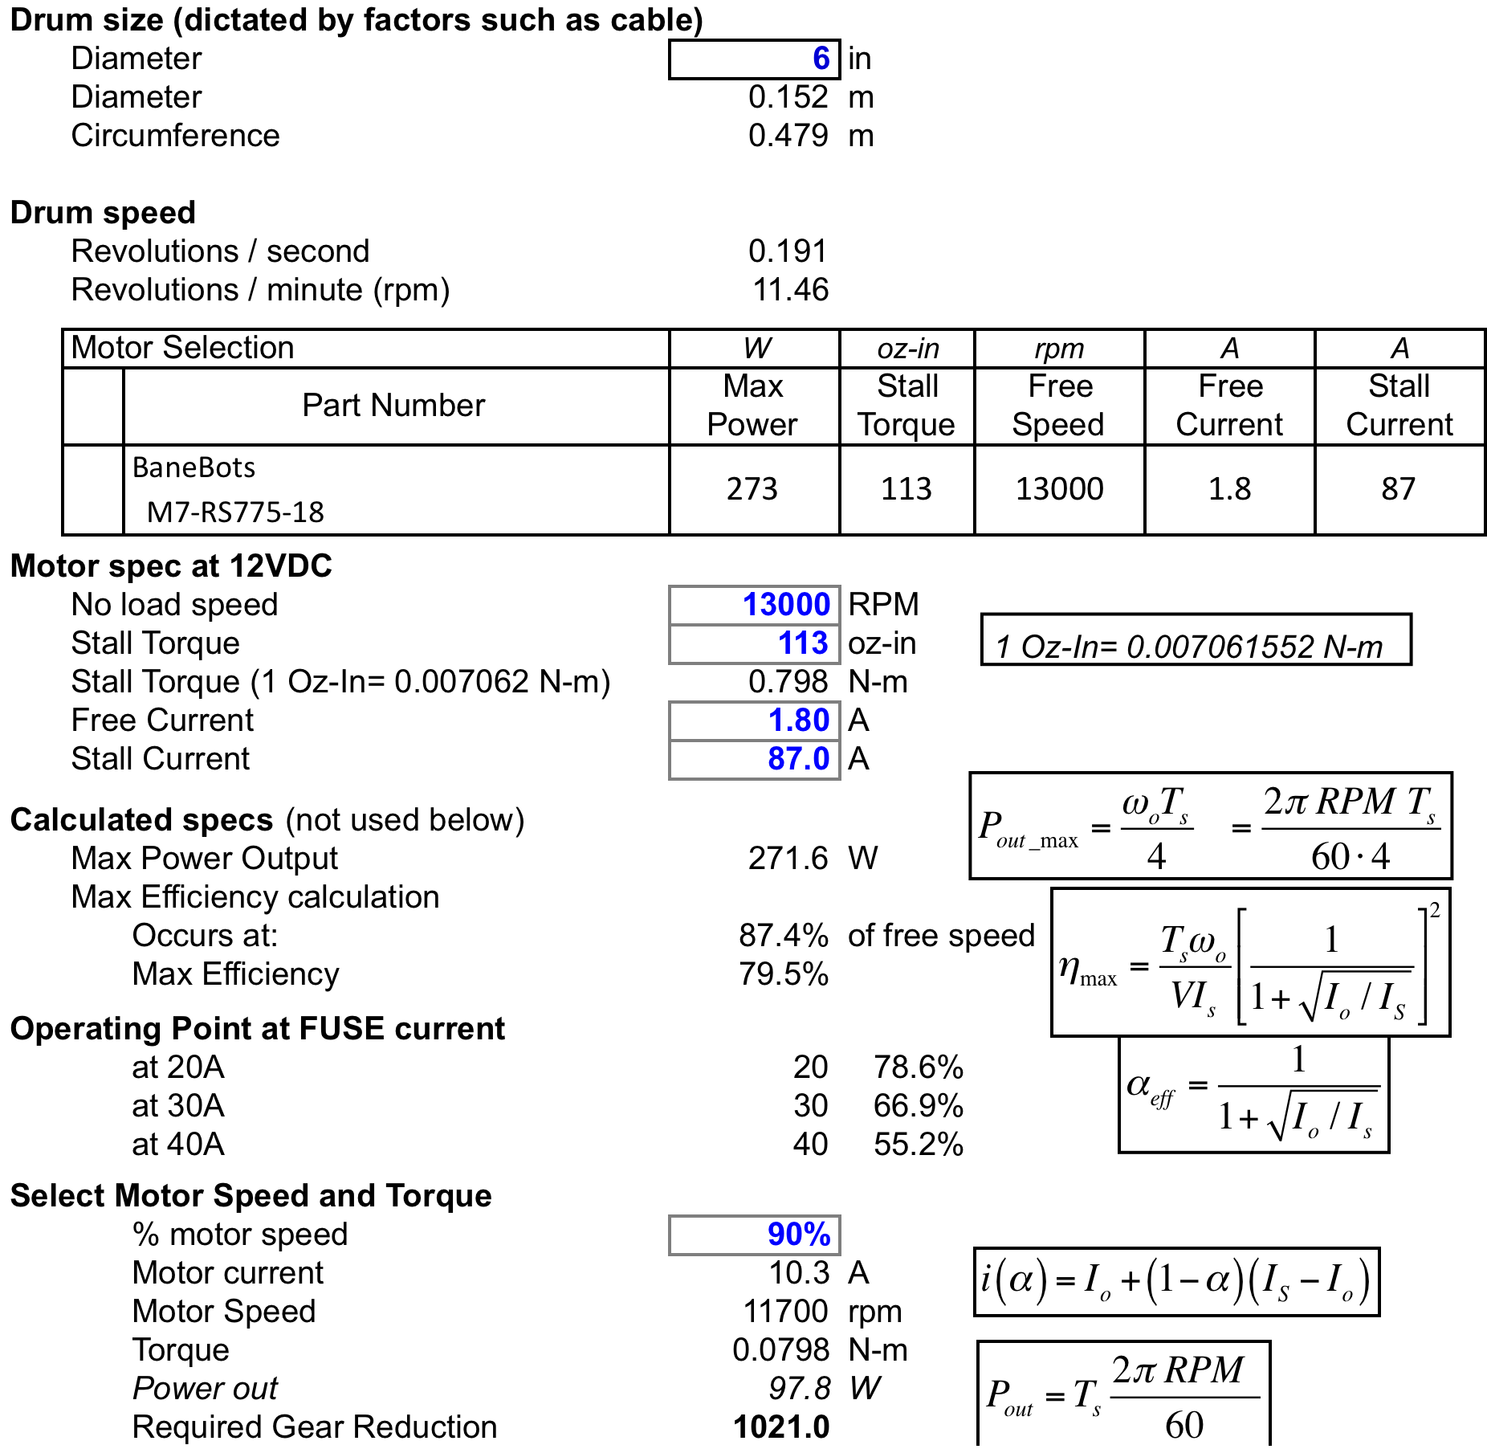
Determine the Gear Reduction
Drum speed
 | Revolutions / second |  | 0.191
 | Revolutions / minute (rpm) |  | 11.46
 | Motor Selection |  | W | oz-in | rpm | A | A
 |  | Part Number | Max Power | Stall Torque | Free Speed | Free Current | Stall Current
 |  | BaneBots M7-RS775-18 | 273 | 113 | 13000 | 1.8 | 87
Motor spec at 12VDC
 | No load speed |  | 13000 | RPM
 | Stall Torque |  | 113 | oz-in
 | Stall Torque (1 Oz-In= 0.007062 N-m) |  | 0.798 | N-m
 | Free Current |  | 1.80 | A
 | Stall Current |  | 87.0 | A
Calculated specs (not used below)
 | Max Power Output |  | 271.6 | W
 | Max Efficiency calculation
 |  | Occurs at: | 87.4% | of free speed
 |  | Max Efficiency | 79.5%
Operating Point at FUSE current
 |  | at 20A | 20 | 78.6%
 |  | at 30A | 30 | 66.9%
 |  | at 40A | 40 | 55.2%
Select Motor Speed and Torque
 |  | % motor speed | 90%
 |  | Motor current | 10.3 | A
 |  | Motor Speed | 11700 | rpm
 |  | Torque | 0.0798 | N-m
 |  | Power out | 97.8 | W
 |  | Required Gear Reduction | 1021.0
Loss estimate assuming 'n' small gear sets
 | Individual gear set reduction ratio |  | 4 | times
 | % Loss per gear set |  | 5%
 | Number of gear reductions |  | 4.998 | sets
 | Total estimated gear efficiency |  | 77.39%

Slide 56
Gear Loss Estimate
 |  | Required Gear Reduction | 1021.0
Loss estimate assuming 'n' small gear sets
 | Individual gear set reduction ratio |  | 4 | times
 | % Loss per gear set |  | 5%
 | Number of gear reductions |  | 4.998 | sets
 | Total estimated gear efficiency |  | 77.39%

Slide 57
Verify We Meet or Exceed Pull Strength Specification
Winch line output at speed
 | Motor torque at speed (above) |  |  | 0.0798 | N-m
 | Torque after gearbox (no loss) |  |  | 81.47 | N-m
 |  | After gear box losses |  | 63.05 | N-m
 | Force on Line |  |  | 827.41 | N
 | Force on Line (lb) |  |  | 185.75 | lb
Margin
 | Weight of load |  |  | 130 | lb
 |  | Margin (force:load at target speed) |  | 1.43 : 1
Notes:
This is a fairly small margin. Recommend a larger margin for greater reliability.

Slide 58
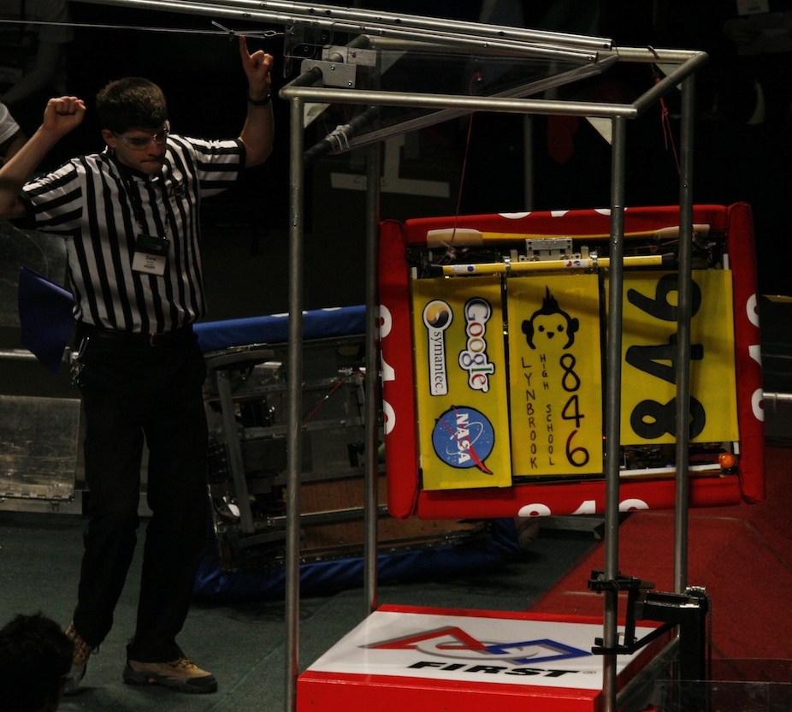
Feat Accomplished!
185 lb exceeds required spec of 130lbs
Notes:
Did we overdesign the winch? How will the winch respond when lifting 130 lbs, if it is pulling with 171 lbs? How do we build this winch?
This is a fairly small margin. A larger margin would give a more reliable lift.

Slide 59
More than you wanted to know about Robot Winch Design
David Giandomenico
Lynbrook High School Robotics
FIRST Team #846
DGiandomenico@lynbrookrobotics.com
(408)343-1183

Slide 60
Addendum: Interest or Time permitting

Slide 61
Notes:
Binomials: Note the binomial coeffients for 1st order y terms. In our case, x=1

Slide 62
Notes:
Yet more! Is there a way to easily determine the binomial coefficients?

Slide 63
Pascal’s Triangle
1
1 1
1 2 1
1 3 3 1
1 4 6 4 1
1
1 1
1 2 1
1 3 3 1
1 4 6 4 1

Slide 64
Binomial Theorem

